Slide 1


am
I ___ a student now.

Slide 2
am
I ___ a student now.
But I _______ a student 6 years ago.
wasn’t

Slide 3

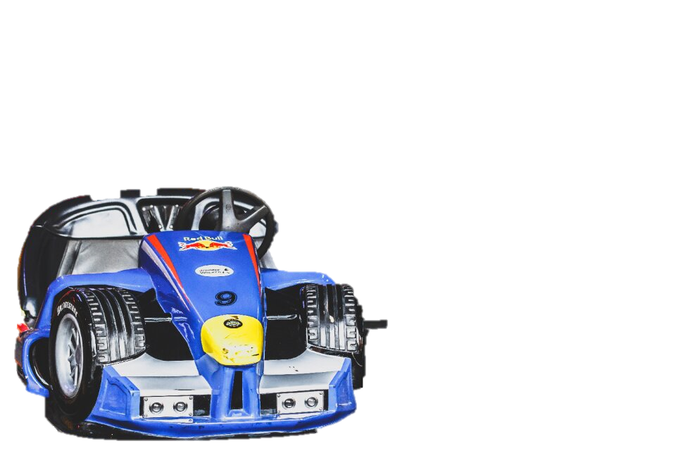

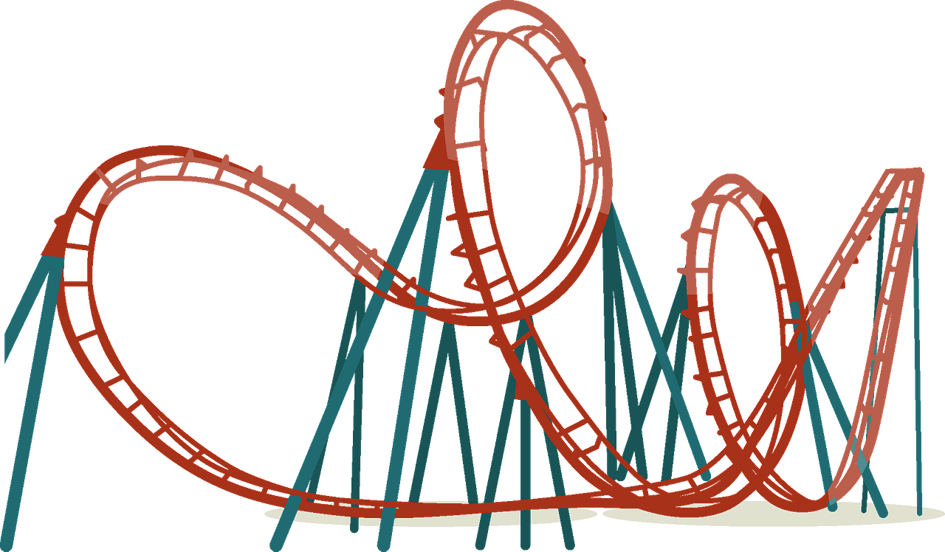
I ______ riding a _________ now.
I ______ riding a _________ 6 years ago.

Slide 4
I ______ riding a _________ now.
I ______ riding a _________ 6 years ago.

Slide 5
I ______ riding a _________ now.
I ______ riding a _________ 6 years ago.

Slide 6
I ______ driving a _________ now.
I ______ driving a _________ 6 years ago.

